Slide 1


Module: Digital Content Creation
Project: InDigital - Inclusive digital competence training for labor market risk groups
Project reference: 2022-1-BG01-KA210-VET-000084442
Learning Material for Adult Learners

Slide 2


Project Consortium

Slide 3
Project Aims:
The inDigital project is aiming at:
Improving the skills of trainers, mentors, training organizations and NGOs to provide training to target groups, without digital skills and at risk in the labor market, including – the unemployed, people without digital skills, and youth out of education and employment;
Increasing curricula’ flexibility for training on basic key competencies, by introducing digital tools, self-assessment methodology, and practical and game techniques to support specific target groups.
Increasing the employability of VET learners facing global challenges related to digital transformation.
Encouraging interaction between educational organizations, trainers, mentors, and NGOs to benefit learners and increase the attractiveness of VET.

Slide 4
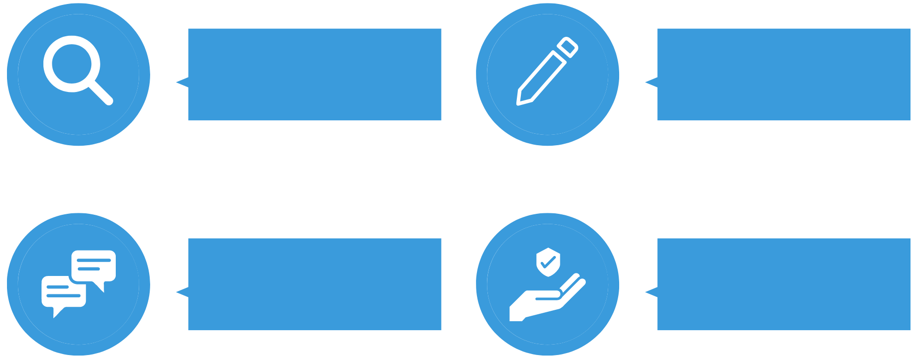
Learning Material Modules
Information &
Data Literacy
Digital Content Creation
Communication &
Collaboration
Safety

Slide 5
01
Introduction & Learning Outcomes
02
Topic 1: Developing Digital Content
Table of
Contents
03
Topic 2: Integrating and re-elaborating digital content
04
Topic 3: Copyright and licenses

Slide 6
Introduction
Module “Digital Content Creation” will encompass topics related to:
Developing of digital content.
Integrating and re-elaborating digital content.
Copyright and licenses and their application to digital information and content.
Basic programming - developing a sequence of understandable instructions for a computing system to solve a given problem or to perform a specific task.
Creative use of digital technologies.

Slide 7
Learning Outcomes
Module “Digital Content Creation” will introduce the learners the following knowledge and skills:
Creation and editing of digital content in different format, to express oneself through digital meaning.
Modifying, refining and integration of new information and content into an existing body of knowledge and resources to create new, original and relevant content and knowledge.
Understanding the copyright and licenses apply to digital information and content.
Planning and developing a sequence of understandable instructions for a computing system to solve a given problem or to perform a specific task.
Solving basic problems related to comprehensive use of digital technologies.

Slide 8


TOPIC 1: DEVELOPING DIGITAL CONTENT
Creating and editing digital content in different format, expressing oneself through digital meaning.
MS Office - word processors, spreadsheets, presentation software.
Digital Communication
Digital communication is the process of creating, sharing, and engaging with content across various platforms and channels. Whether you want to inform, persuade, entertain, or educate your audience, you need to master the tools and techniques for producing and editing high-quality digital content.
To create digital content, like text, data, numbers, and presentations, we have to use a specific digital tool.
The most common tools used by the users are MS Office (license) and Google (docs, spreadsheets, slides).

Slide 9
TOPIC 1: DEVELOPING DIGITAL CONTENT
Creating and editing digital content in different format, expressing oneself through digital meaning.
MS Office - word processors, spreadsheets, presentation software.
Working and creating content with text tools (basic level)
Text is arguably the most common and versatile form of digital content, yet it requires careful planning, writing, and editing.
Depending on your purpose and platform, you may need to alter the formatting, style, and tone of your text.
To help you create and edit text content, some of the best tools available are word processors such as Google Docs or Microsoft Word (MSWord) for writing and formatting documents with collaboration capabilities.
Google Docs - allows users to create and edit documents online while collaborating with other users in real time. Edits are tracked by the user making the edit, with a revision history presenting changes.[1] An editor's position is highlighted with an editor-specific color and cursor, and a permissions system regulates what users can do.
MS Word - used to make professional-quality documents, letters, reports, etc., MS Word is a word processor developed by Microsoft. It has advanced features which allow you to format and edit your files and documents in the best possible way.

Slide 10
TOPIC 1: DEVELOPING DIGITAL CONTENT
Creating and editing digital content in different format, expressing oneself through digital meaning.
MS Office - word processors, spreadsheets, presentation software.
Start creating a text document – MS Word
When writing a document, the content should be the main focus. Document formatting guidelines exist to make that content easier to read and digest.
With Word on your PC, Mac, or mobile device, you can:
Create documents from scratch, or a template.
Add text, images, art, and videos.
Research a topic and find credible sources.
Access your documents from a computer, tablet, or phone with OneDrive.
Share your documents and work with others.
Track and review changes.

Slide 11
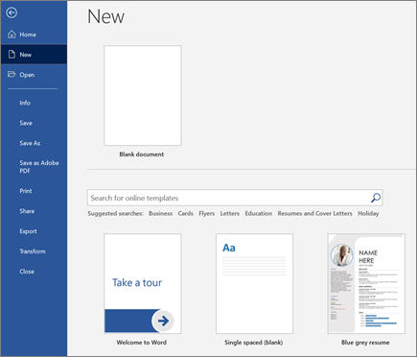
TOPIC 1: DEVELOPING DIGITAL CONTENT
Creating and editing digital content in different format, expressing oneself through digital meaning.
MS Office - word processors, spreadsheets, presentation software.
Create a document – MS Word
Step 1. On the File tab, click New.
Step 2. In the Search menu for online templates box, enter the type of document you want to create, and press ENTER.
Tip: To start from scratch, select Blank document. Or, for practice using Word features, try a learning guide like Welcome to Word, Insert your first table of contents, and more.

Slide 12
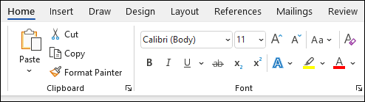
TOPIC 1: DEVELOPING DIGITAL CONTENT
Creating and editing digital content in different format, expressing oneself through digital meaning.
MS Office - word processors, spreadsheets, presentation software.
Add and format text – MS Word
Step 1. Place the cursor and type some text.
Step 2. Select the text and then select an option: Bold, Italic, Bullets, Numbering, and more.
On the Home tab, click the Font Size drop-down arrow. Select a font size from the menu. If the font size you need is not available in the menu, you can click the Font Size box and type the desired size, then press Enter.
The font size will change in the document.
On the Home tab, click the Font Color drop-down arrow.
The Bold, Italic, and Underline commands can be used to help draw attention to important words or phrases.
On the Home tab, click the Change Case command in the Font group.
From the Home tab, click the Text Highlight Color drop-down arrow.
On the Home tab, select one of the four alignment options from the Paragraph group. In our example, we've selected Center Alignment.

Slide 13
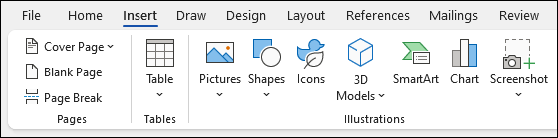
TOPIC 1: DEVELOPING DIGITAL CONTENT
Creating and editing digital content in different format, expressing oneself through digital meaning.
MS Office - word processors, spreadsheets, presentation software.
Add Pictures, Shapes, SmartArt, Chart, and more
Step 1. Select the Insert tab. Select what you want to add:
Tables - select Table, hover over the size you want, and select it.
Pictures - select Pictures, browse for pictures from your computer, select a stock image, or even search Bing.
Shapes - select Shapes and choose a shape from the drop-down.
Icons - select Icons, pick the one you want, and select Insert.
3D Models - select 3D Models, choose from a file or online source, go to the image you want, and select Insert.
SmartArt - select SmartArt, choose a SmartArt Graphic, and select OK.
Chart - select Chart, select the chart you want, and select OK.
Screenshot - select Screenshot and select one from the drop-down.

Slide 14
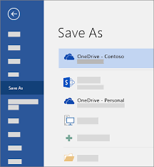
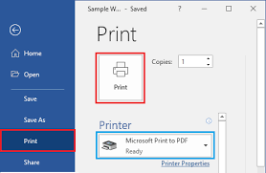
TOPIC 1: DEVELOPING DIGITAL CONTENT
Creating and editing digital content in different format, expressing oneself through digital meaning.
MS Office - word processors, spreadsheets, presentation software.
Save and print a document
Save your document, so you don't lose all your hard work, then print it to share it with others.
Step 1. Click FILE > Save, pick or browse to a folder, type a name for your document in the File name box, and click Save.
Step 12. Save your work as you go - hit Ctrl+S often.
To print, click the FILE tab, and then click Print.

Slide 15
TOPIC 1: DEVELOPING DIGITAL CONTENT
Creating and editing digital content in different format, expressing oneself through digital meaning.
MS Office - word processors, spreadsheets, presentation software.
How to make a Word document look good?
Keep it simple. When writing a document, the content should be the main focus.
Document formatting guidelines exist to make that content easier to read and digest.
Choose a Context-Appropriate Typeface.
Traditional knowledge says that serif fonts are easier to read in printed documents, whereas sans-serif fonts are better on the eyes when read on a digital screen.
Good examples of serif fonts include Garamond, Georgia, Hoefler Text, and Palatino, while good examples of sans-serif fonts include Arial, Gill Sans, Helvetica, and Lucida Sans.
Stick to the same typeface throughout to make your Word document professional. If desired, you can use a different typeface for headings.

Slide 16
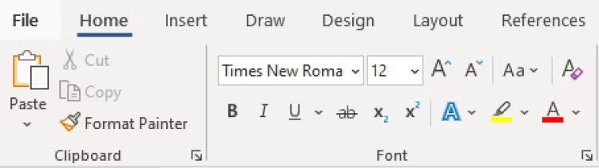
TOPIC 1: DEVELOPING DIGITAL CONTENT
Creating and editing digital content in different format, expressing oneself through digital meaning.
MS Office - word processors, spreadsheets, presentation software.
How to make a Word document look good?
Use Standard Font Size and Colour
Business and academic papers generally use 12-point font sizes, which produce the most readable paragraphs when used in combination with the guidelines discussed below for page size, margins, and line spacing.
Some information-dense reports may sometimes go down to 10-point font size, but never less than that.

Slide 17
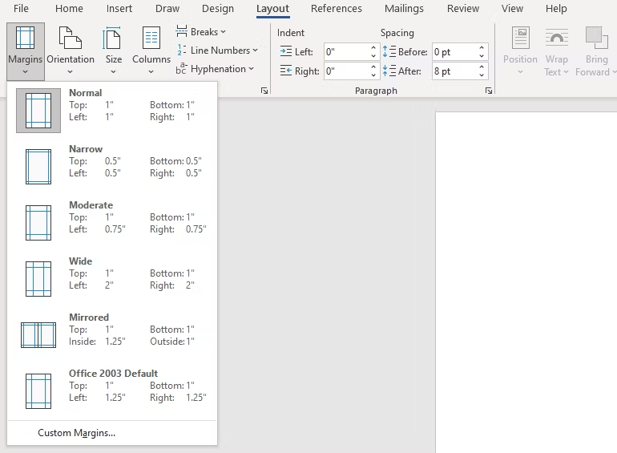
TOPIC 1: DEVELOPING DIGITAL CONTENT
Creating and editing digital content in different format, expressing oneself through digital meaning.
MS Office - word processors, spreadsheets, presentation software.
How to make a Word document look good?
Use Standard Page Size and Margins
Nearly all office documents are formatted to the same page size as they are printed for standard 8½" x 11" pages, known as A4 (US letter size) which is 210mm x 297mm. This is the only size that's guaranteed to be available regardless of which printer you use.

Slide 18
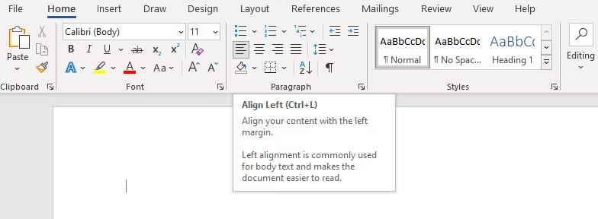
TOPIC 1: DEVELOPING DIGITAL CONTENT
Creating and editing digital content in different format, expressing oneself through digital meaning.
MS Office - word processors, spreadsheets, presentation software.
How to make a Word document look good?
Align Paragraphs
On the Home tab, under Paragraph, click Justify Text .
When you distribute text, space is added between characters so that both edges of each line are aligned with both margins. The last line in the paragraph is distributed as well.
Alignment determines the appearance and orientation of the edges of the paragraph - left-aligned text, right-aligned text, centered text, or justified text, which is aligned evenly along the left and right margins. For example, in a paragraph that is left-aligned (the most common alignment), the left edge of the paragraph is flush with the left margin.

Slide 19
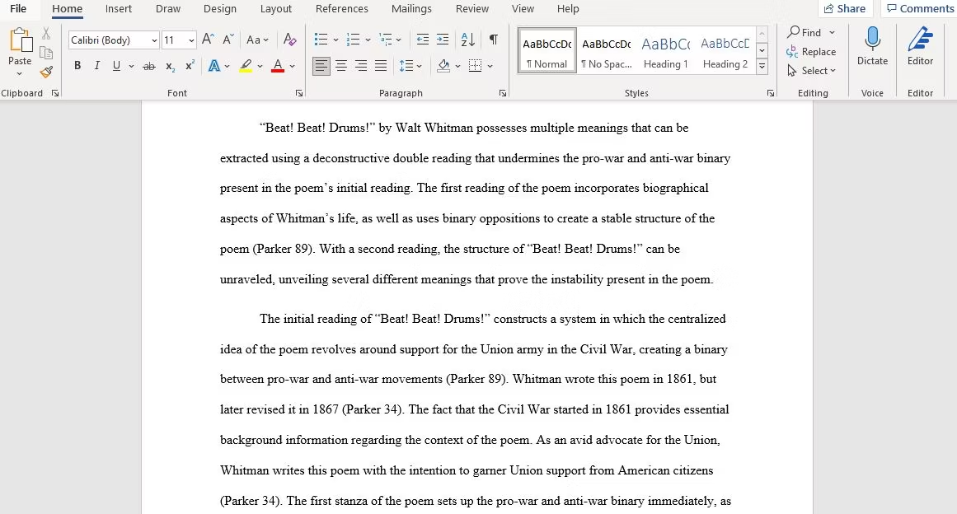
TOPIC 1: DEVELOPING DIGITAL CONTENT
Creating and editing digital content in different format, expressing oneself through digital meaning.
MS Office - word processors, spreadsheets, presentation software.
How to make a Word document look good?
Indent the First Lines of Paragraphs
Paragraphs should have no extra spacing between them, and the first lines of paragraphs should be indented to make each paragraph stand out. The only exception is for paragraphs that directly follow a section heading, which can be left unindented because the surrounding context makes it clear that it's its own paragraph.
To make a document look professional, a general rule of thumb is to have the indent size the same as the font size.

Slide 20
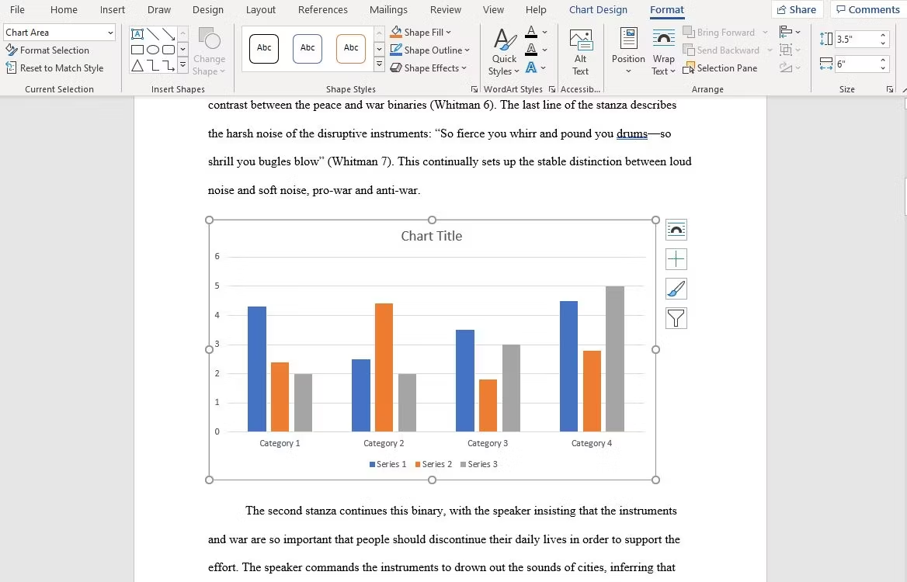
TOPIC 1: DEVELOPING DIGITAL CONTENT
Creating and editing digital content in different format, expressing oneself through digital meaning.
MS Office - word processors, spreadsheets, presentation software.
How to make a Word document look good?
Place Images Between Paragraphs
Inserting images is a part of designing your Word document.
It may be okay to place images inside a paragraph and allow the surrounding text to flow around it, and if your organization follows this document formatting guideline, then go ahead and do that.
The safest option, particularly for graphs, charts, and tables, is to put images in between paragraphs and keep them center aligned. That way, your images help to make your document attractive, but they are never vying for attention with the surrounding text. It also helps captions to stand out.

Slide 21
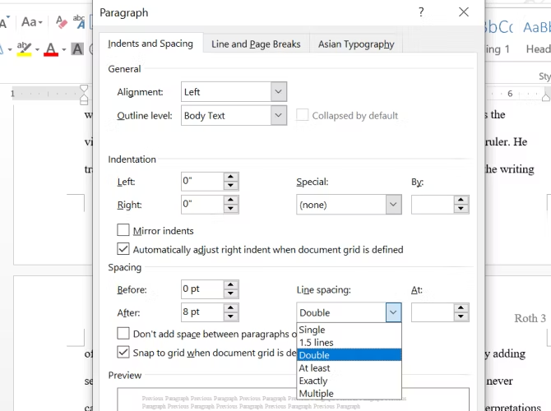
TOPIC 1: DEVELOPING DIGITAL CONTENT
Creating and editing digital content in different format, expressing oneself through digital meaning.
MS Office - word processors, spreadsheets, presentation software.
How to make a Word document look good?
Choose Context-Appropriate Line Spacing
To format a document to look professional, the right choice for line spacing (the whitespace that separates a line of text from the next line of text) really depends on what kind of document you're writing.
Academic papers should first follow any academic style guides in place, then prefer double-spacing if no style guide exists. Business and office documents tend to be single-spaced to minimize the number of pages needed when printing, but digital documents may be easier to read if spaced at somewhere between 120-150 percent.

Slide 22
TOPIC 1: DEVELOPING DIGITAL CONTENT
Creating and editing digital content in different format, expressing oneself through digital meaning.
MS Office - word processors, spreadsheets, presentation software.
How to make a Word document look good?
Choose Context-Appropriate Line Spacing
To format a document to look professional, the right choice for line spacing (the whitespace that separates a line of text from the next line of text) really depends on what kind of document you're writing.
Academic papers should first follow any academic style guides in place, then prefer double-spacing if no style guide exists. Business and office documents tend to be single-spaced to minimize the number of pages needed when printing, but digital documents may be easier to read if spaced at somewhere between 120-150 percent.

Slide 23
MODULE EXERCISES
Creating and editing digital content in different format, expressing oneself through digital meaning.
MS Office - word processors, spreadsheets, presentation software.
Exercise 1:
Open the practice text.
Select the words For Rent and change the font size to 48 pt.
With the text still selected, change the font to Franklin Gothic Demi. Note: If you don't see this font in the menu, you can select a different one.
Use the Change Case command to change For Rent to UPPERCASE.
Change the color of the words For Rent to Gold, Accent 4.
Select all of the text from For Rent to (359-886-222) and Center Align.
Italicize the text in the paragraph below About Villa Roza.
Practice text:
For rent
1000 Villa Roza 15, Magnolia Str.
2 bed 1.5 bath 100 sq.m.
500 EUR per month
Old-styled Bulgarian house in a great location
Won’t last! Available June 1st
Contact Maria Ivanova @ (359-886-222)
About Villa Roza:
Private, but centrally located, historic Villa Roza is just moments from fine dining, shopping and public transportation. Enjoy the beauty of nature and the culture of the vibrant neighborhood.

Slide 24
MODULE EXERCISES
Creating and editing digital content in different format, expressing oneself through digital meaning.
MS Office - word processors, spreadsheets, presentation software.
FOR RENT
1000 Villa Roza 15, Magnolia Str.
2 bed 1.5 bath 100 sq.m.
500 EUR per month
Old-styled Bulgarian house in a great location
Won’t last! Available June 1st
Contact Maria Ivanova @ (359-886-222)
About Villa Roza:
Private, but centrally located, historic Villa Roza is just moments from fine dining, shopping and public transportation. Enjoy the beauty of nature and the culture of the vibrant neighborhood.

Slide 25
TOPIC 1: DEVELOPING DIGITAL CONTENT
Creating and editing digital content in different format, expressing oneself through digital meaning.
MS Office - word processors, spreadsheets, presentation software.
Working and creating content with spreadsheets (basic level)
Microsoft Excel / Google spreadsheets are popular tools for managing data and performing data analysis. They are is used for generating analytical reports, business insights, and storing operational records. To perform simple calculations or analyses on data, we need formulas.
Even simple spreadsheet formulas allow us to manipulate string, number, and date data fields. Furthermore, you can use if-else statements, find and replace, mathematics and trigonometry, finance, logical, and engineering formulas.
What is a formula bar in MS Excel?
Excel formula bar is a special toolbar at the top of the Excel worksheet window, labeled with function symbol (fx). You can use it to enter a new formula or copy an existing one.
The formula bar comes very handy when you are dealing with a pretty long formula, and you want to view it entirely without overlaying the contents of the neighbor cells.
The formula bar gets activated as soon as you type an equal sign in any cell or click anywhere within the bar.

Slide 26
TOPIC 1: DEVELOPING DIGITAL CONTENT
Creating and editing digital content in different format, expressing oneself through digital meaning.
MS Office - word processors, spreadsheets, presentation software.
Working and creating content with spreadsheets (basic level)
There are multiple ways to add formulas:
Dragging down the fill handle: when you select the cell, you will see the small green box at the bottom right. It is called a fill handle. Click and hold the fill handle and drag it down to the last row.
Double click the fill handle: select the cell with the formula and double click the fill handle. Within seconds it will apply the formula to the entire column.
Shortcut: select the cell with the formula and the empty cells below it. Press CTRL + D to apply the formula.
Copy-pasting: copy the cell with the formula (CTRL + C), select the empty rows in a column, and paste it (CTRL + V).

Slide 27
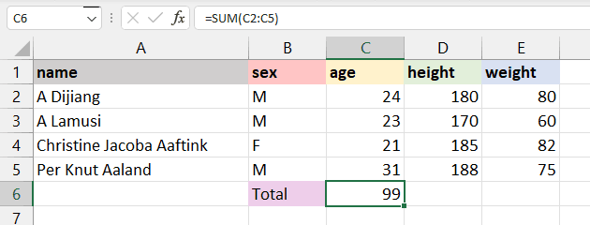
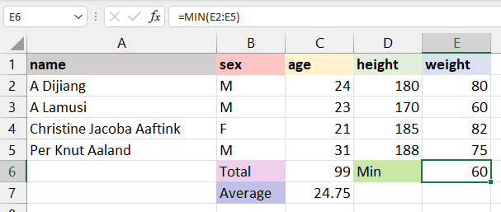
TOPIC 1: DEVELOPING DIGITAL CONTENT
Creating and editing digital content in different format, expressing oneself through digital meaning.
MS Office - word processors, spreadsheets, presentation software.
Basic Formulas in MS Excel
1. SUM
The SUM() formula performs addition on selected cells. It works on cells containing numerical values and requires two or more cells. Example: =SUM(C2:C5)
Apply the SUM formula to a range of cells from C2 to C5 and storing the result on C6. It will add 24, 23, 21, and 31. You can also apply this formula to multiple columns.
2. MIN and MAX
The MIN() formula requires a range of cells, and it returns the minimum value. For example, we want to display the minimum weight among all athletes on the E6 cell. The MIN formula will search for the minimum value and show 60.
Example: =MIN(E2:E5). The MAX() formula is the opposite of MIN(). It will return the maximum value from the selected range of cells.

Slide 28
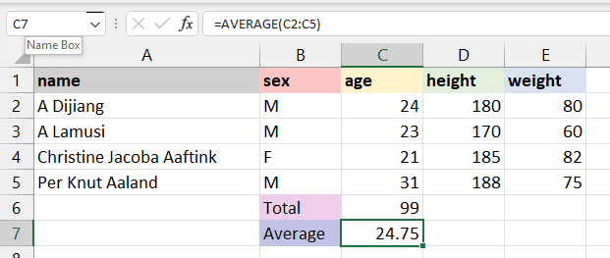
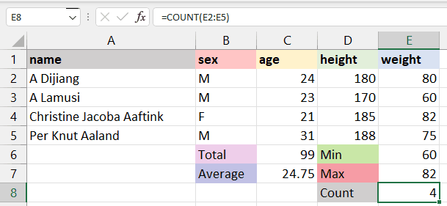
TOPIC 1: DEVELOPING DIGITAL CONTENT
Creating and editing digital content in different format, expressing oneself through digital meaning.
MS Office - word processors, spreadsheets, presentation software.
Basic Formulas in MS Excel
3. AVARAGE
The AVERAGE() formula calculates the average of selected cells. You can provide a range of cells (C2:C5) or select individual cells (C2, C3, C5).
To calculate the average of athletes, we will select the age column, apply the average formula, and return the result to the C7 cell. It will sum up the total values in the selected cells and divide them by 4.
4. COUNT
The COUNT() formula counts the total number of selected cells. It will not count the blank cells and different data formats other than numeric.
We will count the total number of athlete weights, and it will return 4, as we don’t have missing values or strings.

Slide 29
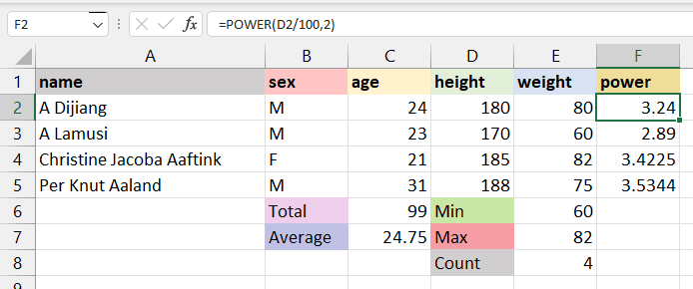
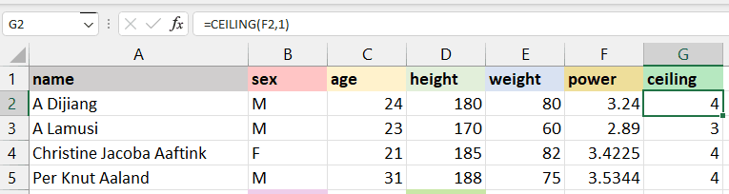
TOPIC 1: DEVELOPING DIGITAL CONTENT
Creating and editing digital content in different format, expressing oneself through digital meaning.
MS Office - word processors, spreadsheets, presentation software.
Basic Formulas in MS Excel
5. POWER
In the beginning, we learned to add power using “^”, which is not an efficient way of applying power to a cell. Instead, we recommended using the POWER() formula to square, cube, or apply any raise to power to your cell.
In our case, we have divided D2 by 100 to get height in meters and squared it by using the POWER formula with the second argument as 2. Example: =POWER(D2/100,2)
6. CEILING and FLOOR
The CEILING() formula rounds a number up to the nearest given multiple. In our case, we will round 3.24 up to a multiple of 1 and get 4. If the multiple is 5, it will round up the number 3.24 to 5. Example: =CEILING(F2,1)

Slide 30
MODULE EXERCISES
Creating and editing digital content in different format, expressing oneself through digital meaning.
MS Office - word processors, spreadsheets, presentation software.
Exercise 1:
Enter the shown data in a spreadsheet.
Find the total for every month of the year.
Find the minimum month value.
Find the maximum month value.
Find the average value.

Slide 31
MODULE EXERCISES
Creating and editing digital content in different format, expressing oneself through digital meaning.
MS Office - word processors, spreadsheets, presentation software.
Exercise 1 - ANSWER
Enter the shown data in a spreadsheet.
Find the total for every month of the year.
Find the minimum month value.
Find the maximum month value.
Find the average value.

Slide 32
TOPIC 1: DEVELOPING DIGITAL CONTENT
Creating and editing digital content in different format, expressing oneself through digital meaning.
MS Office - word processors, spreadsheets, presentation software.
Working and creating content with presentation software (basic level)
Microsoft PowerPoint / Google Slides are slide show presentation programs. The programs use slides to convey information rich in multimedia.
PowerPoint / Google Slide give you the ability to share your presentation with others in real time on the web. You would supply the user with a link to the presentation. After selecting the link, the user(s) will be able to follow you and your presentation online:
Custom animation
Add photos, videos and sound effects
Save as a webpage
Print presentations as handouts
Embed YouTube videos

Slide 33
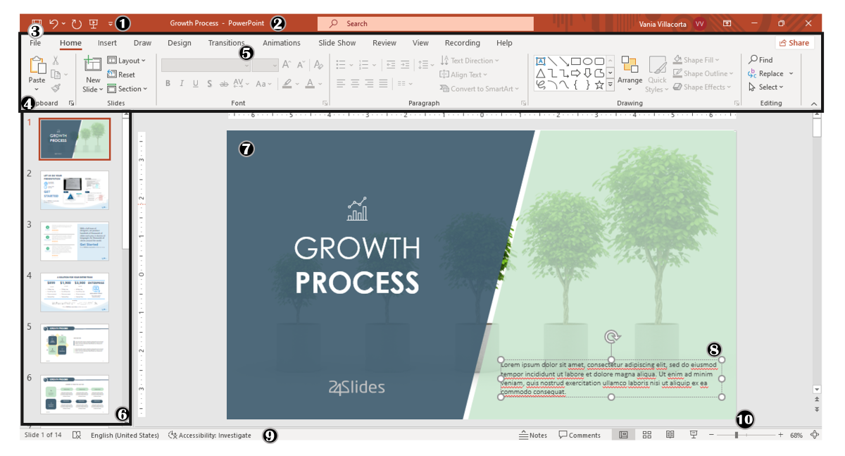
TOPIC 1: DEVELOPING DIGITAL CONTENT
Creating and editing digital content in different format, expressing oneself through digital meaning.
MS Office - word processors, spreadsheets, presentation software.
Working and creating content with presentation software (basic level)
Basic steps to use PowerPoint
The first aspect to learn is PowerPoint Main Window. To facilitate the explanation, main elements are shown with numbers from 1 to 10:

Slide 34
TOPIC 1: DEVELOPING DIGITAL CONTENT
Creating and editing digital content in different format, expressing oneself through digital meaning.
MS Office - word processors, spreadsheets, presentation software.
Working and creating content with presentation software (basic level)
1. Quick Access Toolbar: allows you to customize commands to have them at hand. You only have to select it and go to "More commands".
2. Title Bar: shows you the name of your file and other "Suggested options" like Slide Master View. These options will vary depending on the use you give to the commands.
3. File Tab: you will see the Home Menu (PowerPoint backstage) by selecting it. There, you can create a new presentation, save it, print it, export it, and many other options.
4. The Ribbon: it's where PowerPoint tabs and tools are. These tools can also be called "commands" or “features”.
5. More Button or Down Arrow: these arrows allow you to view more tools or layout options in PowerPoint.

Slide 35
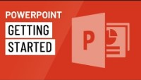
TOPIC 1: DEVELOPING DIGITAL CONTENT
Creating and editing digital content in different format, expressing oneself through digital meaning.
MS Office - word processors, spreadsheets, presentation software.
Working and creating content with presentation software (basic level)
6. Slides Pane: shows your slides in thumbnail size. By right-clicking, you can access additional options for customizing each slide. Perfect for PowerPoint beginners!
7. Slide: PowerPoint's blank canvas and the frame to be seen when presenting the file.
8. Placeholders: they are dotted boxes that will store your content.
9. Status Bar: allows you to view the slide number, grammatical errors, speaker notes, and the comments on your file.
10. Zoom: allows you to enlarge or minimize your PowerPoint workspace. The range goes from 10 to 400%.
Source: @GCFLearnFree

Slide 36
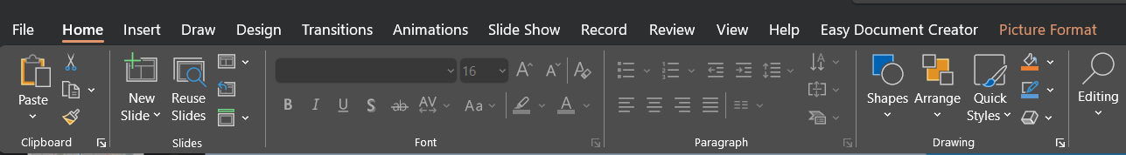
TOPIC 1: DEVELOPING DIGITAL CONTENT
Creating and editing digital content in different format, expressing oneself through digital meaning.
MS Office - word processors, spreadsheets, presentation software.
Working and creating content with presentation software (basic level)
Home Tab
The Home tab is the most common tab of PowerPoint. This is the tab you’ll probably use the most if you're designing a presentation deck from scratch.
It allows you to add new slides and change the text characteristics: font, size, boldness, underlining, alignment, etc. If you've ever used Microsoft Word, these features will be familiar to you.
Also, you will find commands to edit the characteristics of the geometric shapes you insert. This includes fill color, line color, shape effects, among others.

Slide 37
TOPIC 1: DEVELOPING DIGITAL CONTENT
Creating and editing digital content in different format, expressing oneself through digital meaning.
MS Office - word processors, spreadsheets, presentation software.
Working and creating content with presentation software (basic level)
Insert Tab
The Insert tab is exactly what its name says it is. In this ribbon, you'll find all the options concerning adding a new element to your PowerPoint presentation.
You can insert a picture, some geometric shapes, icons, WordArt graphics, among others. We can tell you that this tab is really helpful for PowerPoint beginners!
For example, if you have a lot of data in PowerPoint, you could add a chart or diagram to show your information in a more visual way. Also, you can embed videos or music into PowerPoint really easily.

Slide 38
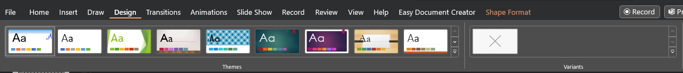
TOPIC 1: DEVELOPING DIGITAL CONTENT
Creating and editing digital content in different format, expressing oneself through digital meaning.
MS Office - word processors, spreadsheets, presentation software.
Working and creating content with presentation software (basic level)
Design Tab
The Design tab offers a wide range of premade designs, allowing you to get more polished slides. Even better, if you explore its ribbon, you can adjust the color palette and change the overall style of your PowerPoint deck.
If you're inspired and want to create your own background in PowerPoint, this presentation design software can help you. Just go to: Design Tab > Variants > Background Styles > Format Background > Choose or create a design for your slides!

Slide 39
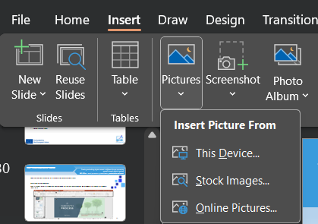
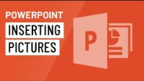
TOPIC 1: DEVELOPING DIGITAL CONTENT
Creating and editing digital content in different format, expressing oneself through digital meaning.
MS Office - word processors, spreadsheets, presentation software.
Working and creating content with presentation software
Inserting pictures and videos
Depending on which version of PowerPoint you're using, you can insert pictures, photos, clip art, or other images to your slide show from your computer or from the Internet.
Click where you want to insert the picture on the slide.
On the Insert tab, in the Images group, click Pictures and then click This Device.
In the dialog box that opens, browse to the picture that you want to insert, click that picture, and then click Insert.
Embed a video stored on your PC
In Normal view, click the slide that you want the video to be in.
On the Insert tab, click the arrow under Video, and then click Video on My PC. In the Insert Video box, click the video that you want, and then click Insert.
Insert picture:
Insert video:
Source: @GCFLearnFree

Slide 40
MODULE EXERCISES
Creating and editing digital content in different format, expressing oneself through digital meaning.
MS Office - word processors, spreadsheets, presentation software.
Exercise 1:
Make a presentation – write a poster with info and image/s
Choose a design - Navigate to PowerPoint on your computer and open the software. Start with a blank template. It does not matter which version of PowerPoint you use to create a poster design.
Set Dimensions and Poster Size - Pick a size for your poster design. Design the PowerPoint poster at the maximum size it will be printed.
Add Text - Once you have the layout set, add all text elements to the poster design. Remember to keep the goal of the design in mind and keep text limited to only what’s necessary, such as an event name, time, date, and location.
Add Images - Bring images and other design elements you want to use into the poster design. Drag and drop each image from your folder into the poster design

Slide 41
TOPIC 2: Integrating and re-elaborating digital content
Create, format, and edit digital content – in practice.
Practical task: create, format, and edit documents in ready-made templates (resume and business letter).
Resume - CV
Employers typically form their first impressions of job candidates based on their resumes.
Submitting a clean, properly formatted, well-written and error-free resume may increase your chances of securing consideration for a position and progressing toward the next step in the hiring process.
Learning more about how to use resume templates in Microsoft Word can help you create an effective document that showcases your skills.
Practice: Locating a resume template in MS Word
Microsoft offers resume templates for free through the Microsoft Word program.
You can find them in the Resume Wizard by clicking "File," "New" and "Other." You can download many additional free resume templates from Microsoft Office's website.
What is a business letter?
A business letter is a letter from one company to another, or such organizations and their customers, clients, or other external parties. The overall style of letter depends on the relationship between the parties concerned.

Slide 42
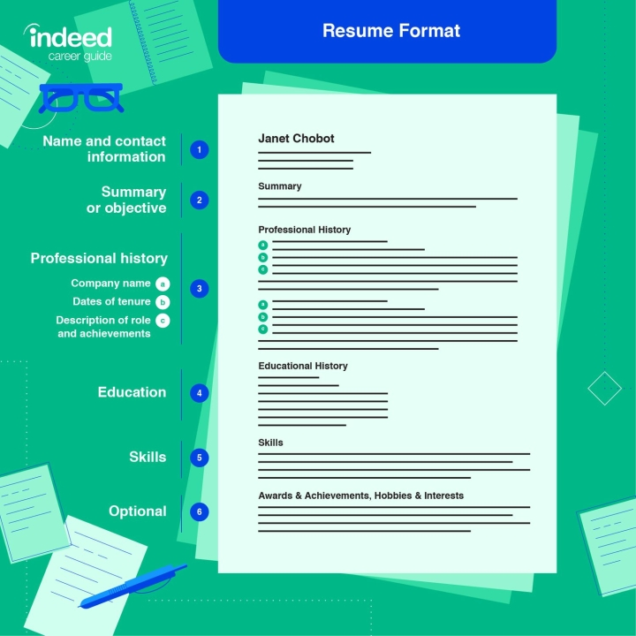
TOPIC 2: Integrating and re-elaborating digital content
Create, format, and edit digital content – in practice.
"Resume Format" is the title of this infographic that shows an image of an example resume.
On the left side of the infographic, a numbered list points to each section of the resume.
- Name and contact information
- Summary or objective
- Professional history: company name / dates of tenure / description of role and achievement
- Education
- Skills
-Optional (Awards & Achievements, Hobbies & Interests)
Give the file a specific name - rename your file so it's easy to identify. Your full name or first initial followed by your last name is a good option.
Proofread - make sure you proofread and spellcheck all text before you share it with an employer.
Source: www.indeed.com

Slide 43
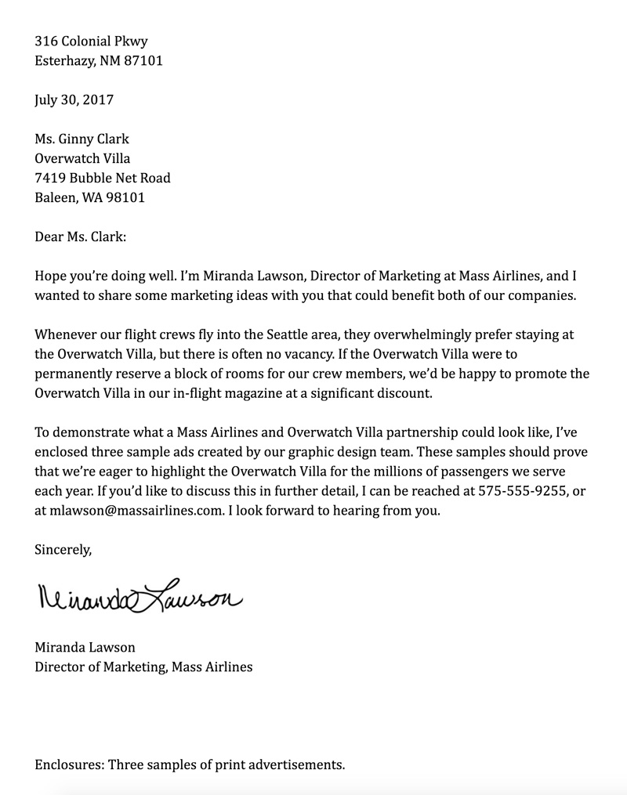
TOPIC 2: Integrating and re-elaborating digital content
Create, format, and edit digital content – in practice.
A business letter is a formal letter. Unlike a résumé or cover letter, it can be more than one page, and is likely to contain six parts:
The Heading
The heading contains the return address with the date on the last line. Sometimes it is necessary to include a line before the date with a phone number, fax number, or e-mail address. Type a return address if you are not using stationery with the return address already imprinted and use a date. The heading is on the left margin.
The Body
For block and modified block letter formats, single space and left justify each paragraph. Be sure to leave a blank line between each paragraph, however, no matter the format. Be sure to also skip a line between the salutation and the body, as well as the body and the close.
The Complimentary Close
The complimentary close is a short and polite remark that ends your letter. The close begins at the same justification as your date and one line after the last body paragraph. Capitalize the first word of your closing (Thank you) and leave four lines for a signature between the close and the sender’s name. A comma should follow the closing.
The Signature Line
This line will include your first and last name. You may put your title beforehand to show how you wish to be addressed (Ms., Mrs., Dr.). The signature should be in blue or black ink.
Source: www.edu.gcfglobal.org

Slide 44
MODULE EXERCISE
Create, format, and edit digital content – in practice.
Practical task: Use of templates related to the labour market
1. Open a new Word document
In Word, click New from the File menu. Next, type business cards into the search field at the top of the page.
2. Review and choose your favourite template
Decide which template style represents your brand and core values.
Related: Core Values: Overview and Examples
3. Fill in relevant information within the template
Include the following elements above in your business card:
Name: Your name is part of your personal brand, so make sure it's easy to read on your business card.
Personal tagline: Produce a tagline that best represents the service you provide.
Email: Provide your email address, so contacts can reach you about future opportunities.
4. Format elements to build your design
Switch fonts, colours and sizes to your liking within the template. The template is only there as a guide to help build a business card that markets your professional brand. However, be sure to make your business card readable so your network can understand what you're communicating to them.

Slide 45
MODULE EXERCISE
Create, format, and edit digital content – in practice.
Practical task: Create presentations using MS PowerPoint/ Google slides.
1. Pick a theme.
2. Pick a layout for your slides.
3. Add text.
4. Add a picture.
5. Add transitions between slides.
6. Present your slide show.
7. Share your presentation online.

Slide 46
TOPIC 3: Copyright and licenses
Protection of copyrights on the Internet, licenses for the use of software and digital content.
Free use licenses (Creative Commons).
What are licenses?
Licenses are permissions given by the copyright holder for their content.
Licenses can be applied to copyrighted material in order to give permission for certain uses of the material. Copyright is still held by the creator in these cases, but the creator has decided to allow others to use their work. Sometimes licenses are purchased and sometimes they are given freely by the creator.
Licenses can be applied to allow reuse, redistribution, derivative works, and commercial use.
Creative Commons is the most frequently used and accessible free licensing scheme, but there are others that are used by certain communities. Licenses can also be applied by commercial entities that own copyright to an item such as a journal article.
These licenses generally spell out limited usage for users and are available for a fee.

Slide 47
TOPIC 3: Copyright and licenses
Protection of copyrights on the Internet, licenses for the use of software and digital content.
Free use licenses (Creative Commons).
License Terminology
A license can be written from scratch, but most people choose a well-known one. We’ll cover the common licenses that relate to our industry of website design and development, specifically those that allow for free usage — “free,” meaning that no money is required. Generally, licenses that govern paid resources are written individually, but all licenses have commonalities. Before we dive into them, let’s go over some common terminology:
“Copy” A simple copy of the original work.
“Modify” To alter copyrighted work in some way before using it.
“Derivative work” The result of modifying copyrighted work to produce new work.
“Distribute” The act of giving someone your work under a license.
“Redistribute” The act of distributing work and its license after obtaining it under license from the original copyright owner.
“Share alike” Permission to distribute derivative work under the same or a similar license.
“Credit” or “attribution” The act of identifying the original copyright owner.
“Copyright notice” A written phrase or symbol (©) informing of copyright ownership (not necessarily required by law).
“All rights reserved” A common copyright notice declaring that no usage rights exist (again, not necessarily required).
“Warranty” A written guarantee included with the license (or, usually, not).

Slide 48
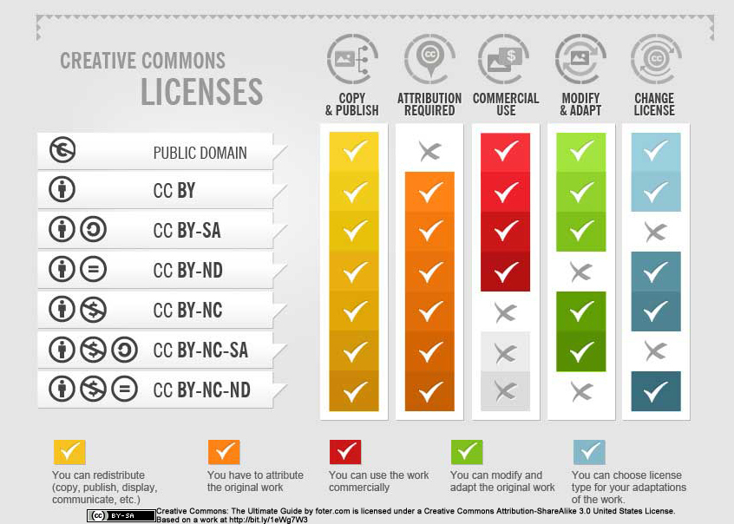
TOPIC 3: Copyright and licenses
Protection of copyrights on the Internet, licenses for the use of software and digital content.
Free use licenses (Creative Commons).
Creative Commons
Creative Commons licenses are applied by the copyright owner to their own works. These are the most prominently used licenses of their type in the world. There are four components to the licenses that are arranged in six configurations:
BY - attribution required.
NC - no commercial use.
ND - no derivative works.
SA - Share Alike - the license must be the same on any derivative works.

Slide 49
TOPIC 3: Copyright and licenses
Protection of copyrights on the Internet, licenses for the use of software and digital content.
Free use licenses (Creative Commons).
Citing sources on the Internet
What are electronic sources?
An electronic source is any information source in digital format. The library subscribes to many electronic information resources in order to provide access for students.
Electronic sources can include full-text journals, newspapers, company information, e-books, dictionaries, encyclopaedias, economic data, digital images, industry profiles, market research, etc.
Should I include extra information when I cite electronic sources?
Referencing electronic or online sources can be confusing—it's difficult to know which information to include or where to find it. As a rule, provide as much information as possible concerning authorship, location and availability.
Electronic or online sources require much of the same information as print sources (author, year of publication, title, publisher). However, in some cases extra information may be required:
the page, paragraph or section number—what you cite will depend on the information available as many electronic or online sources don’t have pages.
identify the format of the source accessed, for example, E-book, podcast etc.
provide an accurate access date for online sources, that is, identify when a source was viewed or downloaded.
provide the location of an online source, for example, a database or web address.

Slide 50
References & Resources:
www.edu.gcfglobal.org
www.youtube.com/@GCFLearnFree
www.Indeed.com
www.Microsoft.com
@Insider Tech – YouTube

Slide 51
Information &
Data Literacy
Digital Content Creation
Inclusive digital competence training for labor market risk groups
Communication &
Collaboration
Safety
THIS PROJECT HAS BEEN FUNDED WITH SUPPORT FROM THE EUROPEAN COMMISSION – APPLICATION NUMBER 2022-1-BG01-KA210-VET-000084442. THIS PUBLICATION REFLECTS THE VIEWS ONLY OF THE AUTHOR, AND THE COMMISSION CANNOT BE HELD RESPONSIBLE FOR ANY USE WHICH MAY BE MADE OF THE INFORMATION CONTAINED THREIN.

